Slide 1
PROJECTION OF SOLID
16 MARKS
Visit for more Learning Resources

Slide 2
CO’S RELATED THIS CHAPTER
VISUALIZE AND DRAW THE PROJECTION OF DIFFERENT CUT MODEL OF REGULAR SOLID

Slide 3
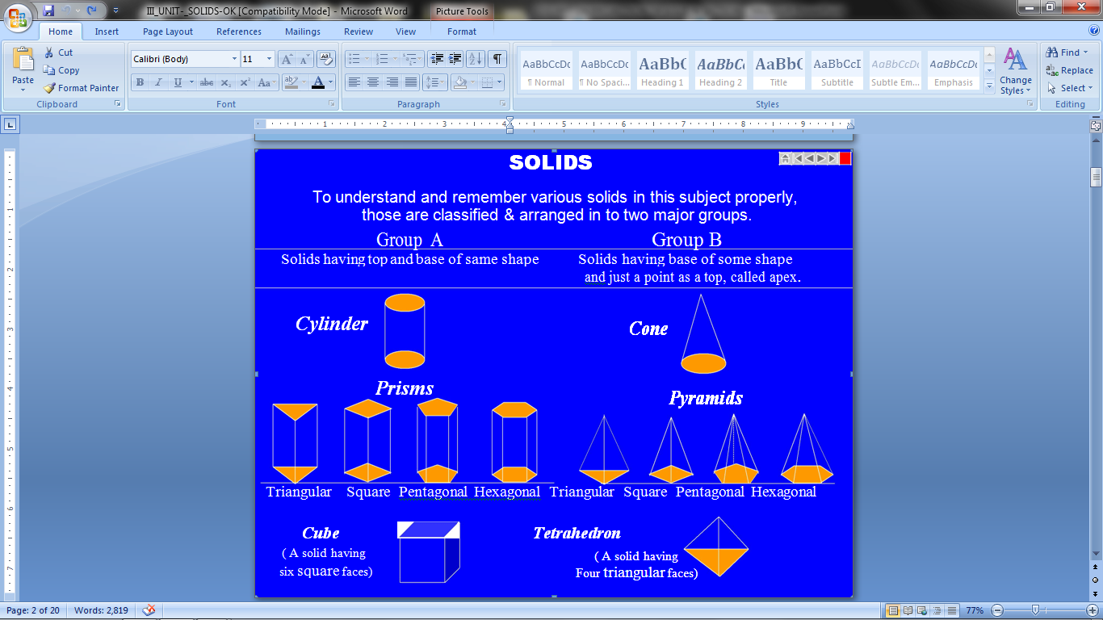
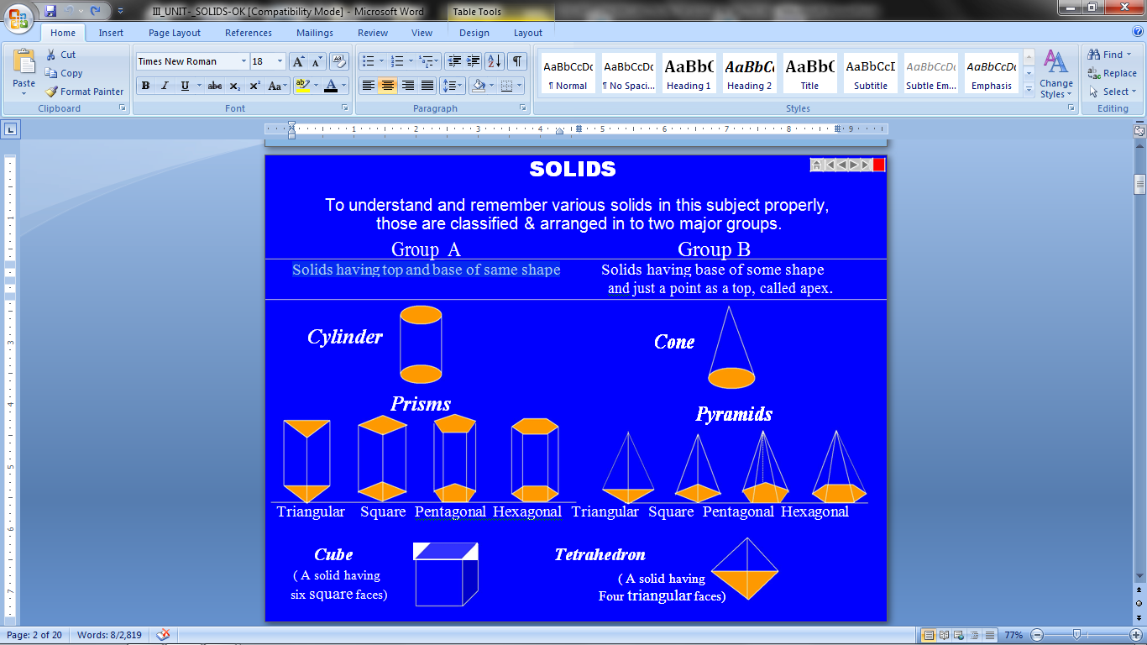
TO UNDERSTAND AND REMEMBER VARIOUS SOLIDS IN THIS SUBJECT PROPERLY, THOSE ARE CLASSIFIED & ARRANGED IN TO TWO MAJOR GROUPS
GROUP A
Solids having top and base of same shape
GROUP B
Solids having base of some shape and just a point as a top, called apex

Slide 4
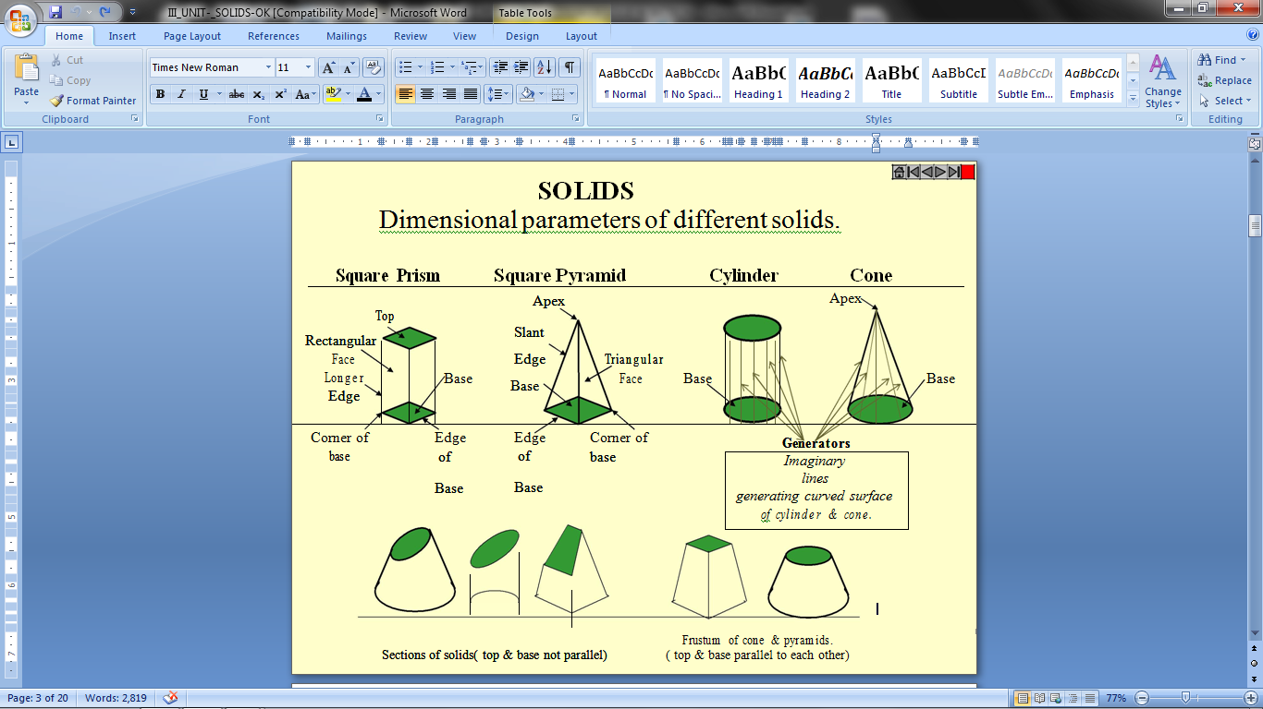

Slide 5
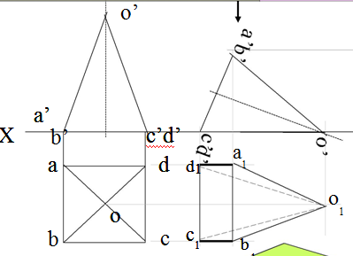
Problem 1. A square pyramid, 40mm base sides and axis 60 mm long, has a triangular face on the ground and the vertical plane containing the axis makes an angle of 45⁰ with the VP. Draw its projections. Take apex nearer to VP

Slide 6
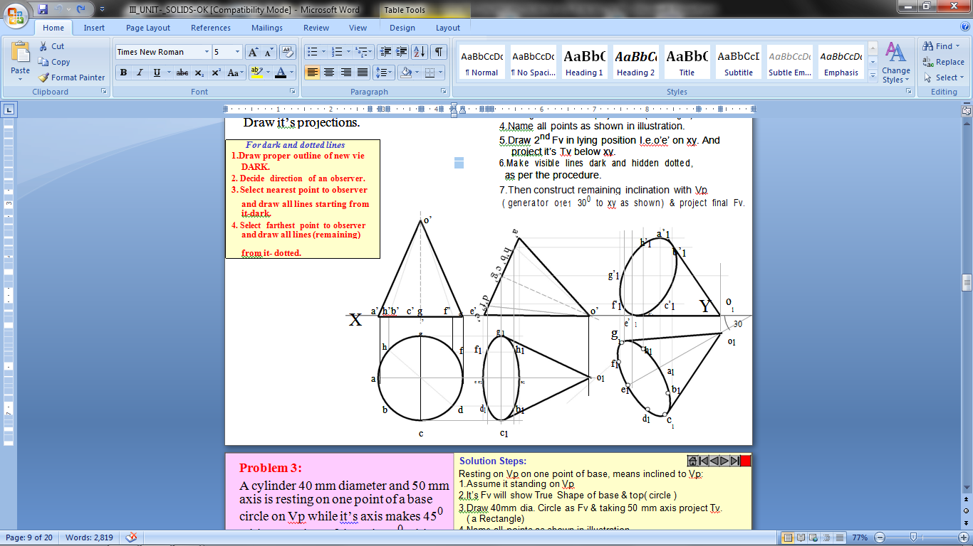
Problem 2: A cone 40 mm diameter and 50 mm axis is resting on one generator on Hp which makes 30⁰ inclination with Vp .Draw it’s projections.

Slide 7
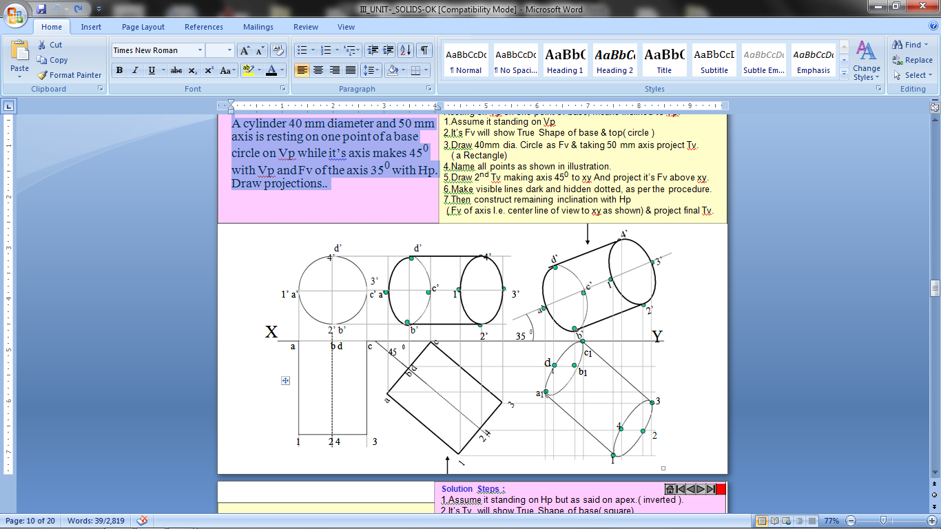
Problem 3:
A cylinder 40 mm diameter and 50 mm axis is resting on one point of a base circle on Vp while it’s axis makes 45⁰ with Vp and Fv of the axis 35⁰ with Hp. Draw projections..
For more detail contact us

